Slide 1
CED Budget Analysis
BU Spark! DS 594

Slide 2
Overview
User Story 1: As a Program Director, I would like to know if operations budgets for the last several years have been underutilized so that I can advocate for a transfer of this variance to participatory budgeting.
Datasets Used:
2024 budget dataset was provided in the Spark! Google Drive class folder for this project and includes 2024 & 2023 budget, and 2022 & 2021 spending.
To get the budget and spending for all other years dating back to 2018, we tabulated Budget Appropriation tables from the PDFs of the Budget Book.

Slide 3
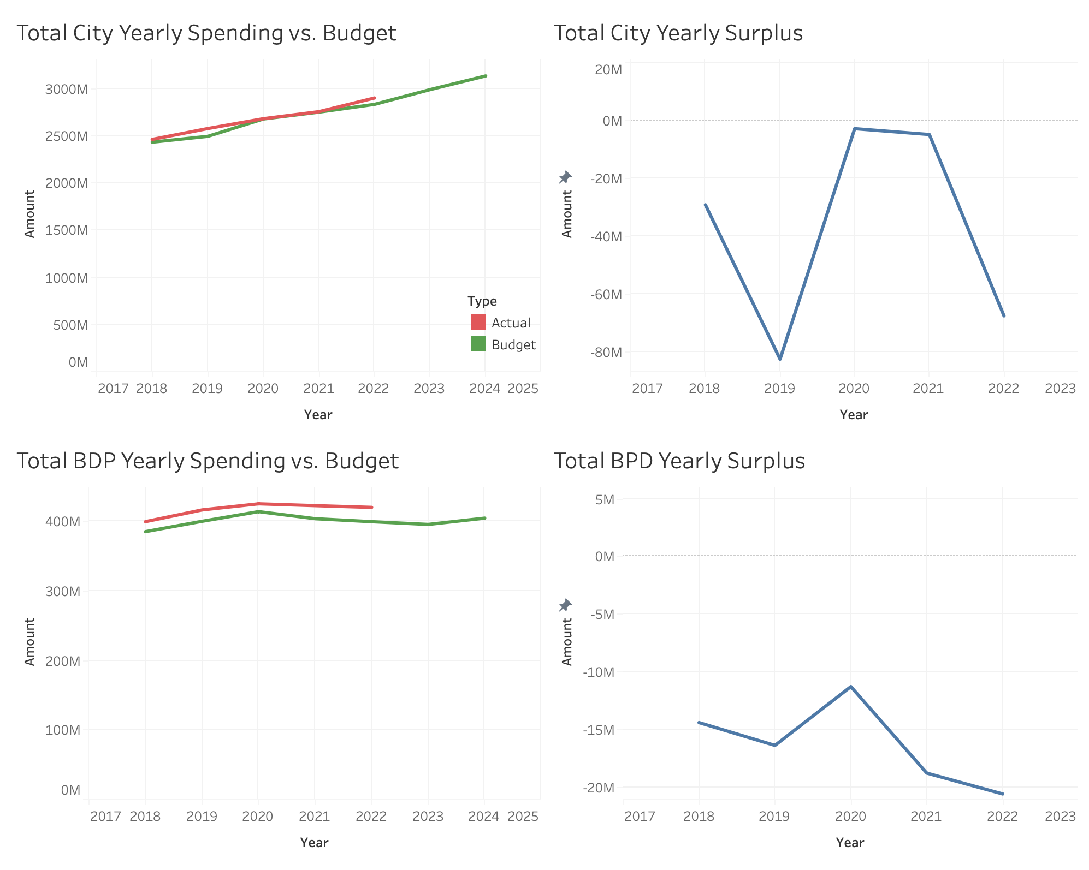
Overall City and BDP Spending
The City of Boston has a negative surplus (difference between actual spending and allocated budget) of -$37M on average between 2018 and 2022 (except during COVID-19 when the city budget was fully utilized).
Boston Police Department has a negative surplus of -$16M on average between 2018 and 2022.
Total city budgets and total BPD budgets display negative surplus each year, indicating they are not being underutilized,

Slide 4
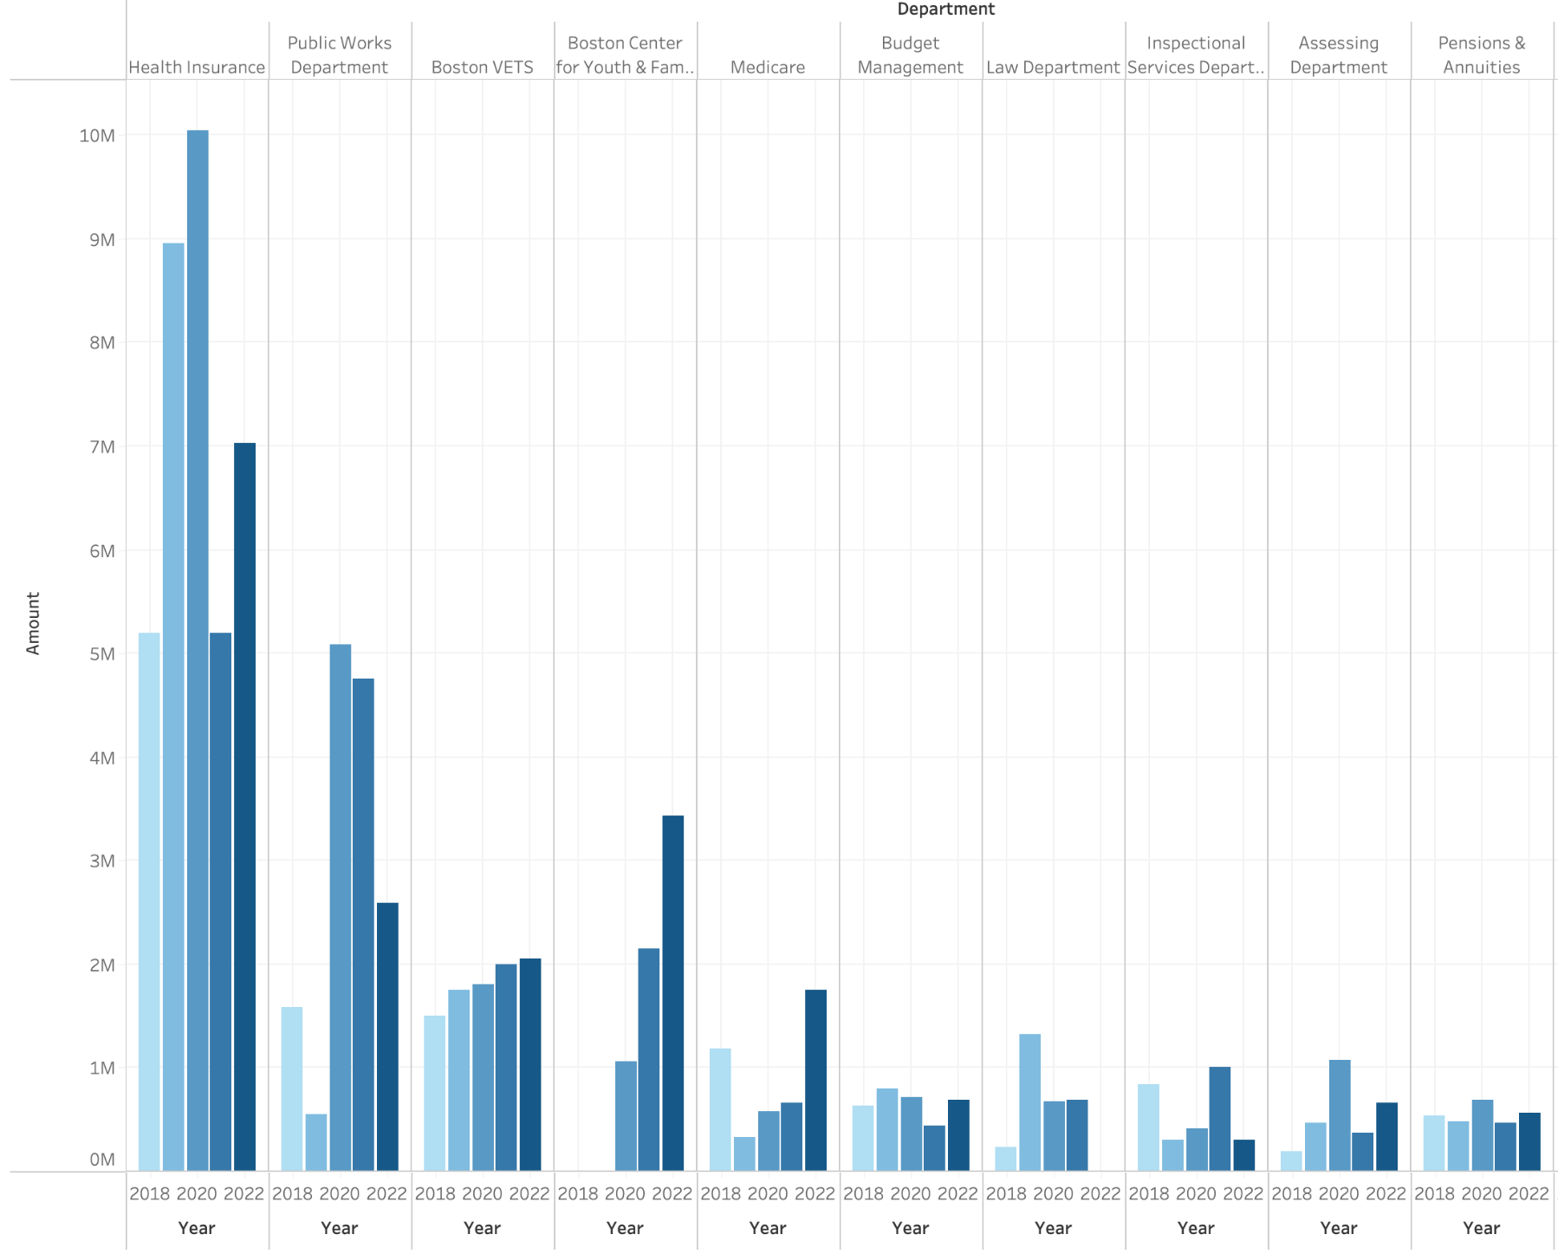
Departments with Highest Average Surplus
This chart shows the top 10 departments with the highest budget surplus on average between 2018 and 2022. Of these ten, the top 5 departments with highest average yearly surplus are:
Health Insurance
Public Works Department
Boston VETS
Boston Center for Youth & Engagement
Medicare

Slide 5
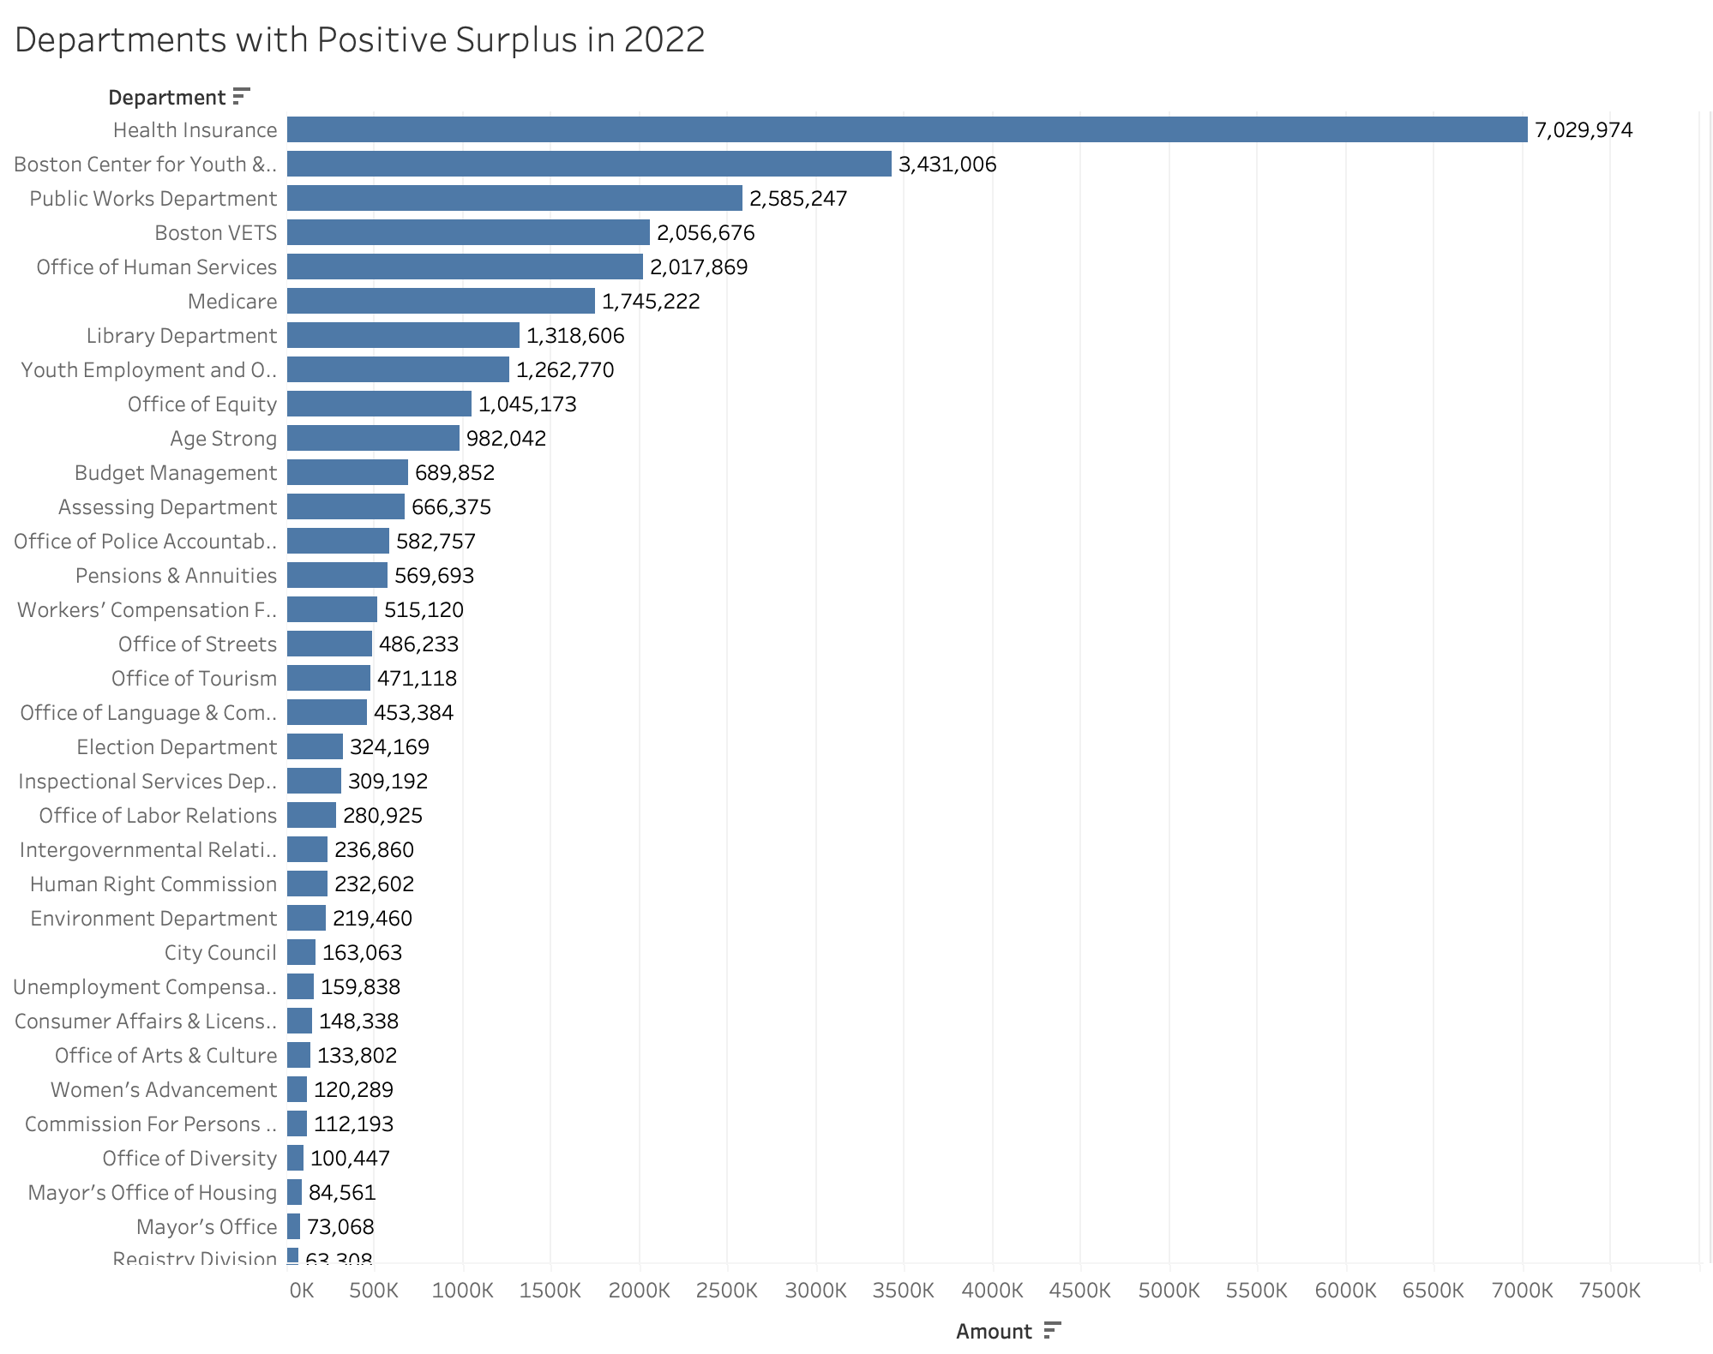
Departments with Positive Surplus in 2022
There are 9 departments that recently had over $1M in surplus (2022). Of these the top 3 are Health Insurance, Center for Youth & Families, and the Public Works Department. Across all departments with surplus, the total departmental surplus was around $30M in 2022.
For a closer look into a departmental breakdown of underutilization, we have split these departments into evenly sized groups for further analysis:
1. | $1M < Surplus | 9 departments
2. | $400K < Surplus < $1M | 9 departments
3. | $140K < Surplus < $400K | 10 departments
4. | $0 < Surplus < $140K | 10 departments

Slide 6
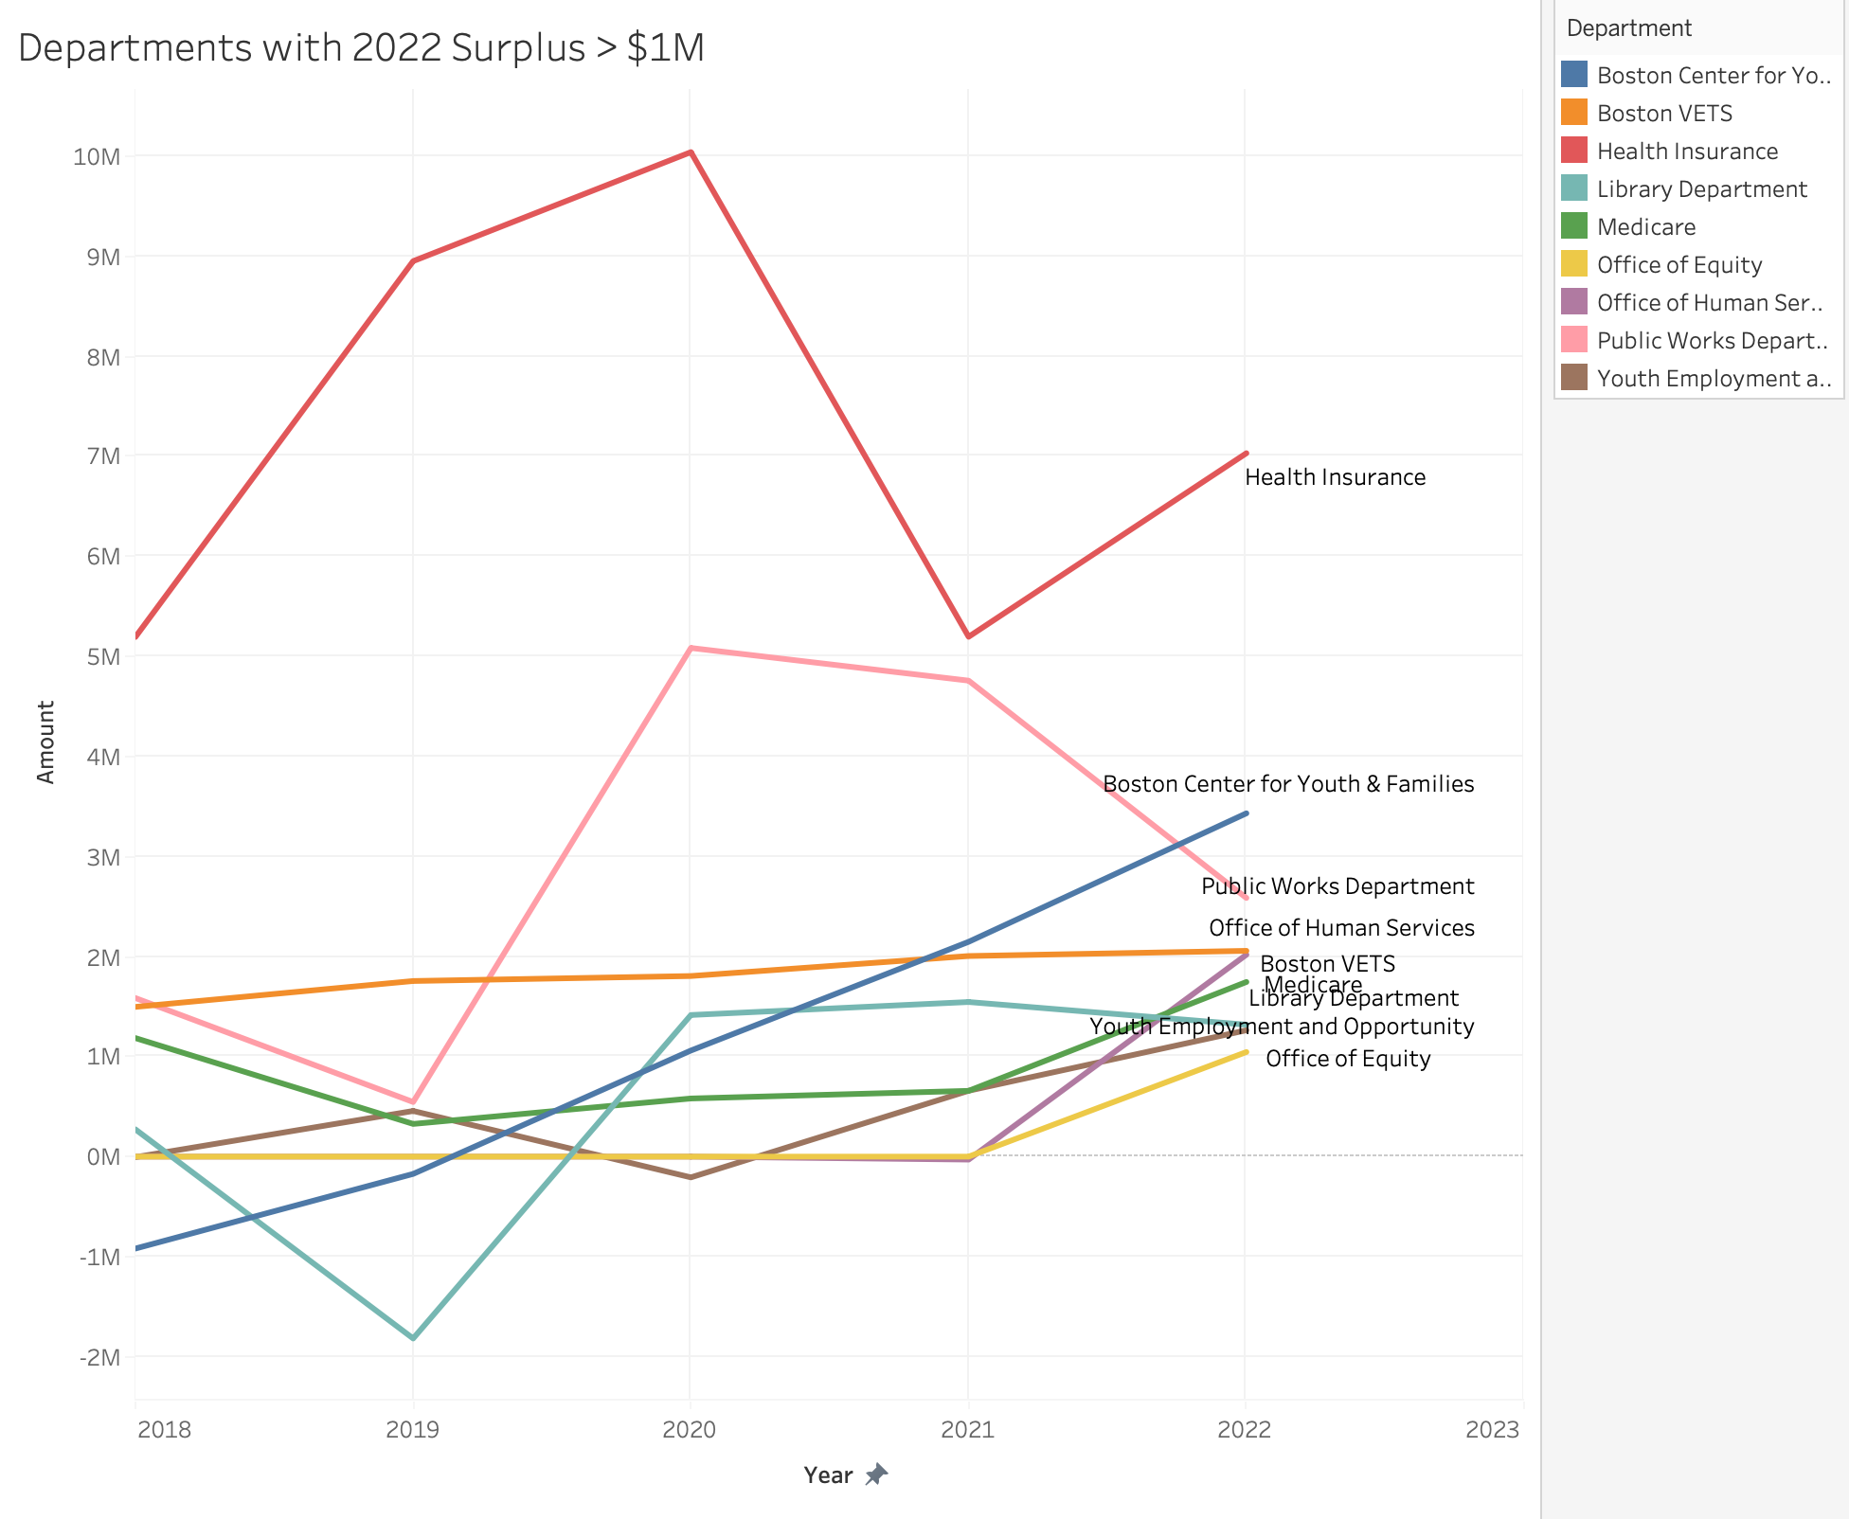
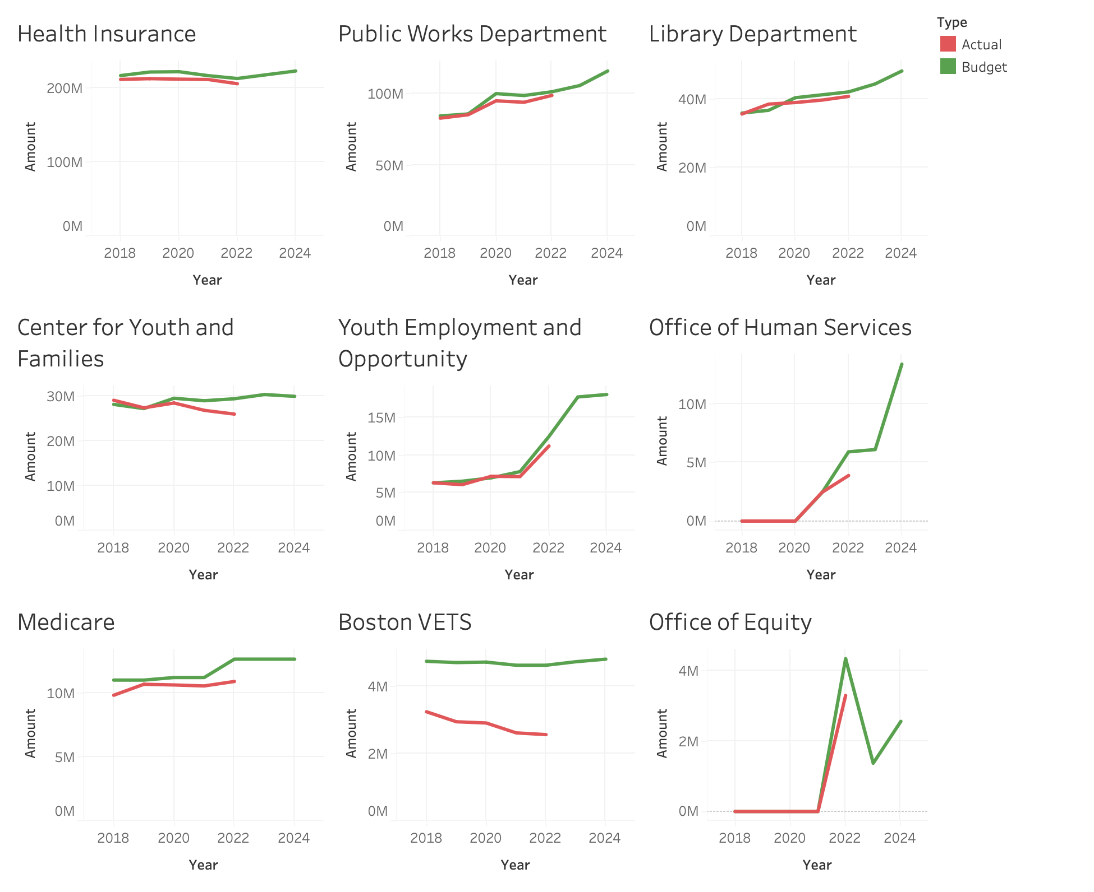
1. Departments with 2022 Surplus > $1M
The left shows the yearly trends of top departments with the most surplus in 2022 (the most recent year of surplus data). On the right is a more detailed breakdown of each of these departments’ yearly budgets and spending, ordered by the size of the department budget.

Slide 7
Takeaways
Total budget for City of Boston and the Boston Police Department do not show any underutilization (negative surplus) between 2018 and 2022.
There are 38 other departments that do show budget underutilization (positive surplus) between 2018 and 2022.
These departments with surplus consist of:
9 departments with $1M < 2022 surplus
9 departments with $400K < 2022 surplus < $1M
10 departments with $140K < 2022 surplus < $400K
10 departments with $1 < 2022 surplus < $140K.

Slide 8
Questions
(Slide 4 & 6) - To determine which departments have most budget underutilization, should we filter departments with the highest surplus in just 2022 (the most recent year) or the highest surplus on average (from all 2018-2022)?
(Slide 6) - For the breakdown of departmental budgets and spending, should this grid be ordered by amount of surplus, or by department size/impact (budget amount of the department)?
(Slide 5) - For departments with surplus, what is the range of surplus per year that we should analyze further ($1M, $500K, $100K)?
Next steps?

Slide 9
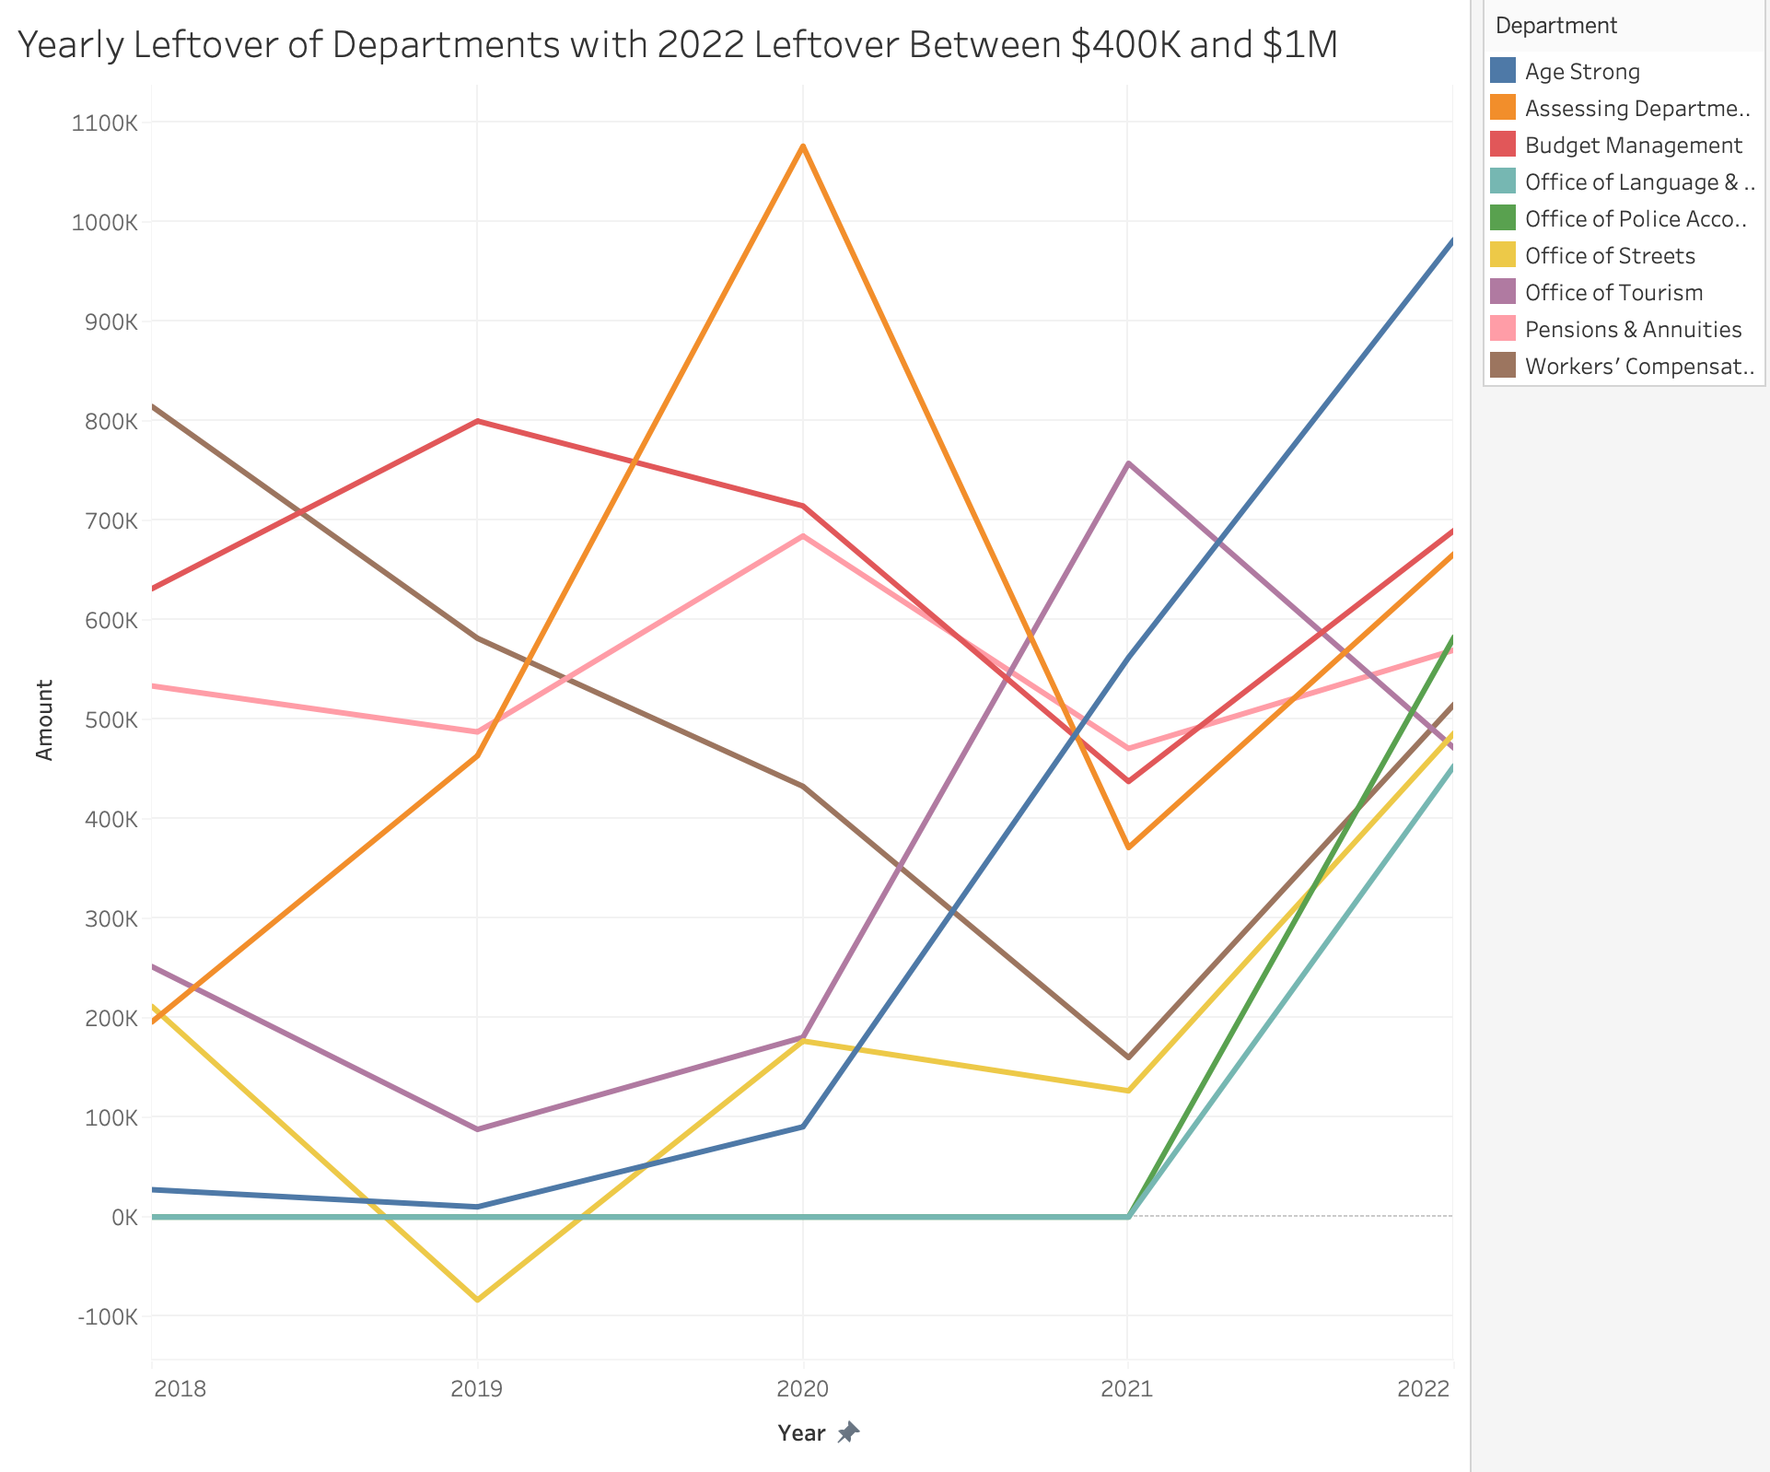
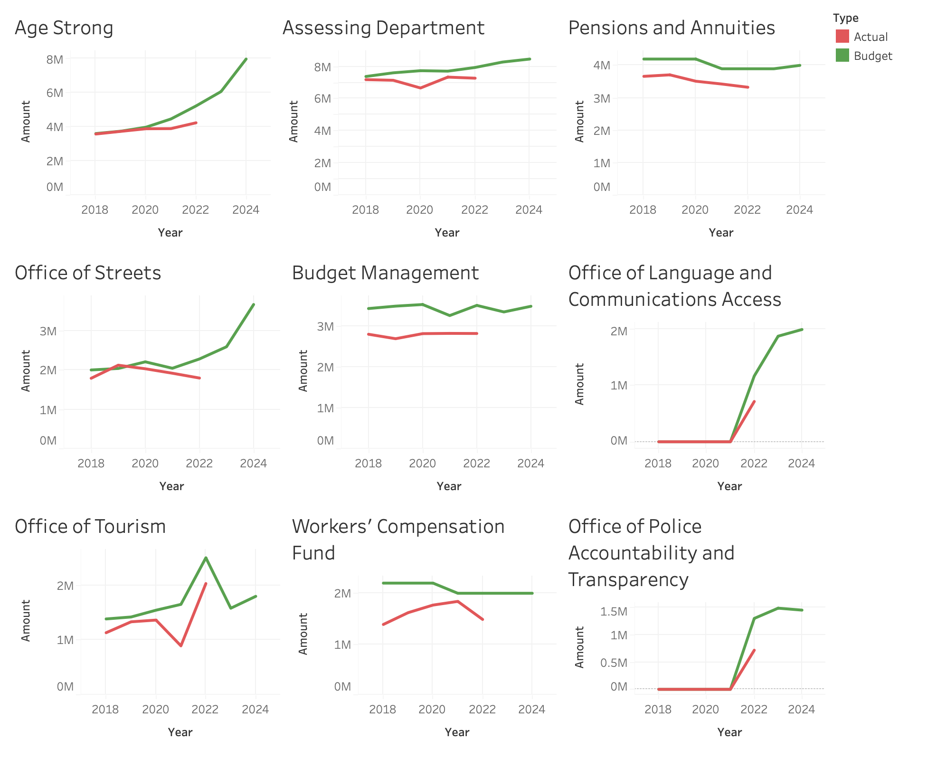
What is the take away?
2. Departments with 2022 Surplus Between $400K and $1M
What is the take away?

Slide 10
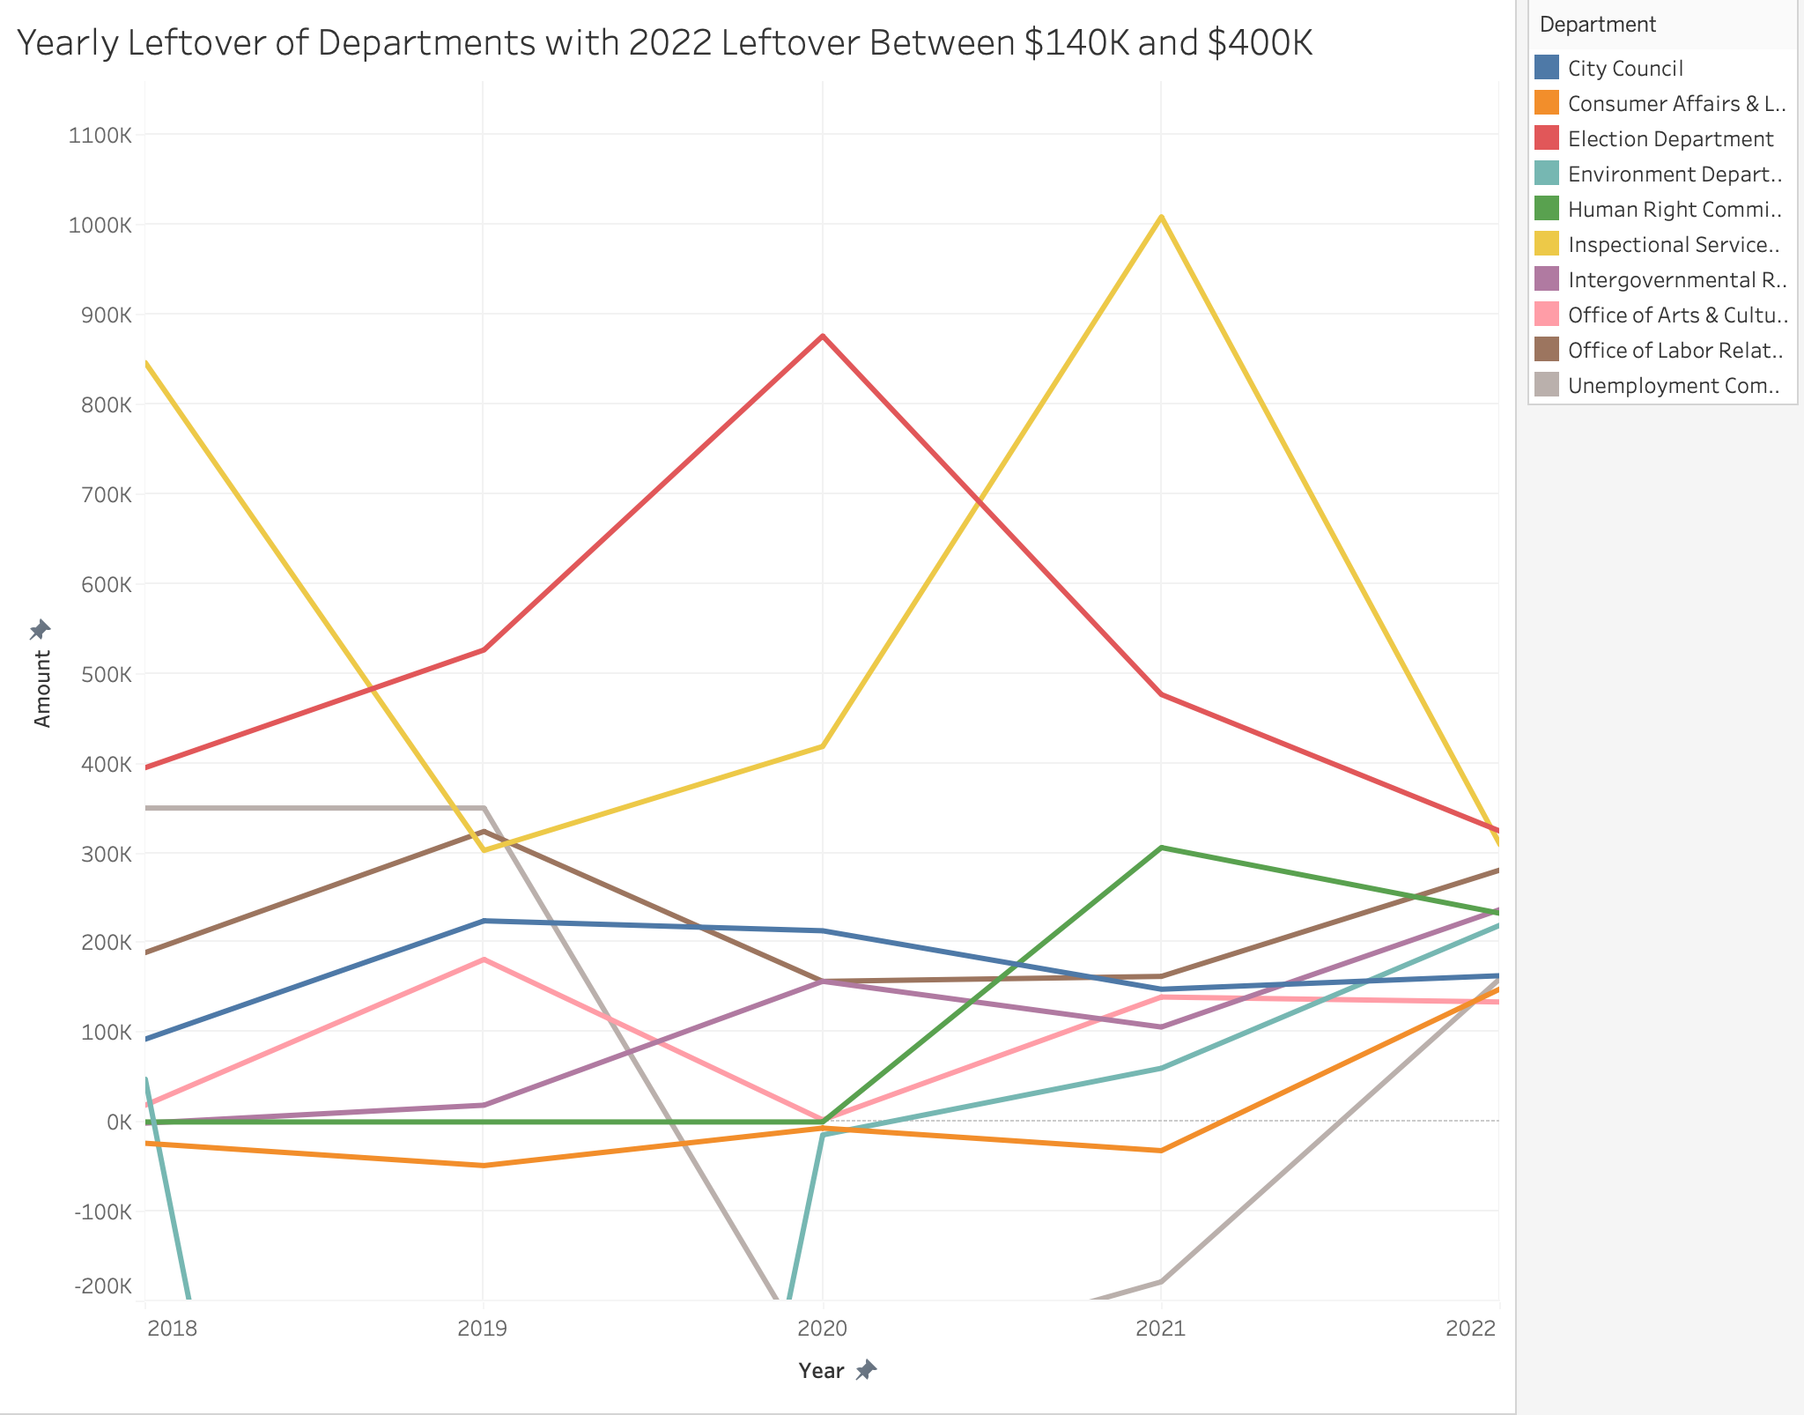
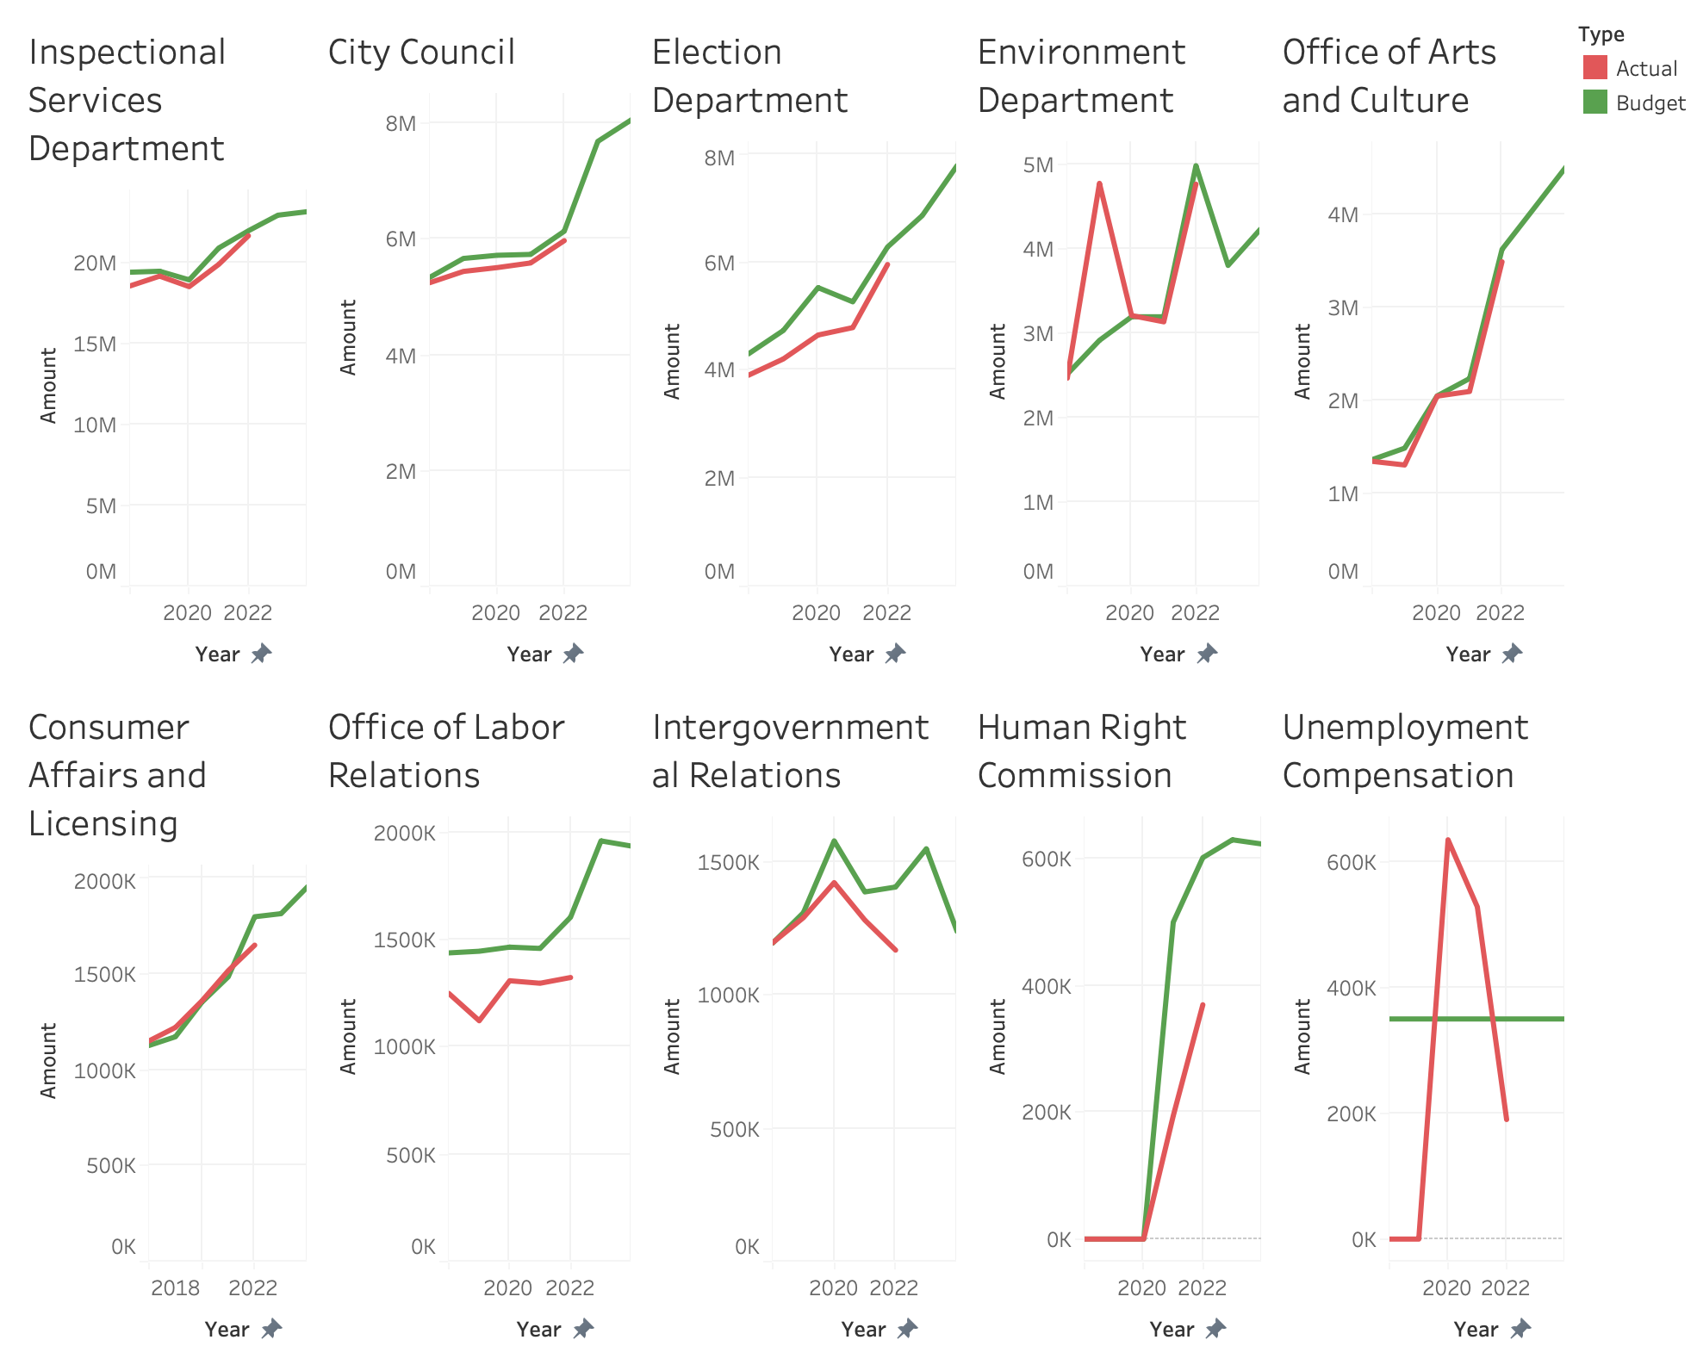
What is the take away?
3. Departments with 2022 Surplus Between $140K and $400K
What is the take away?

Slide 11
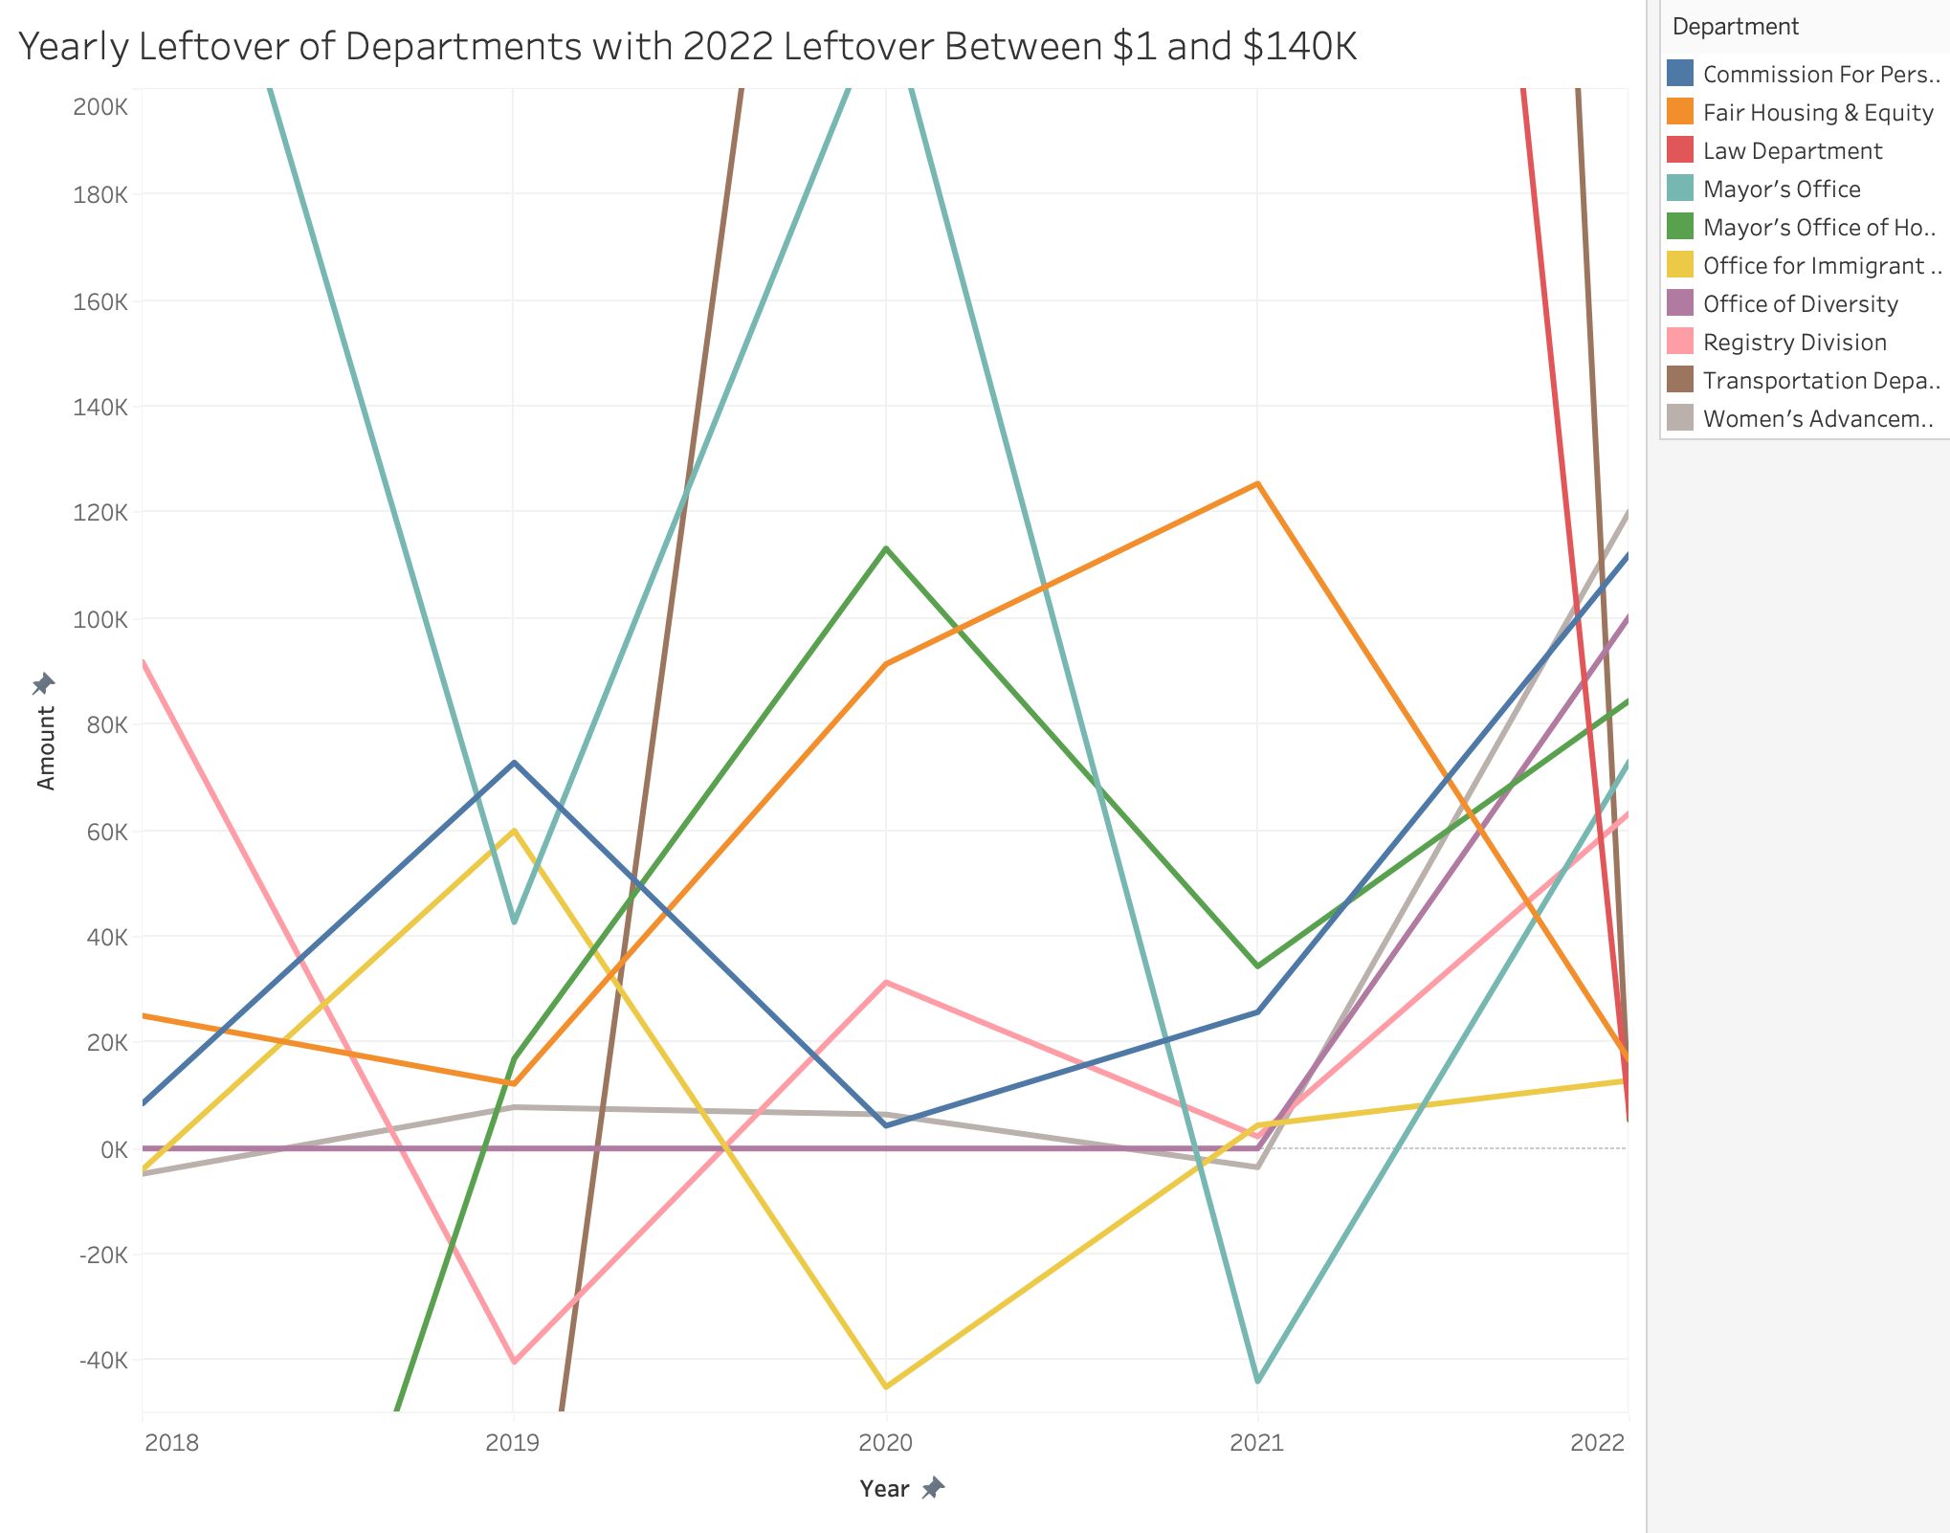
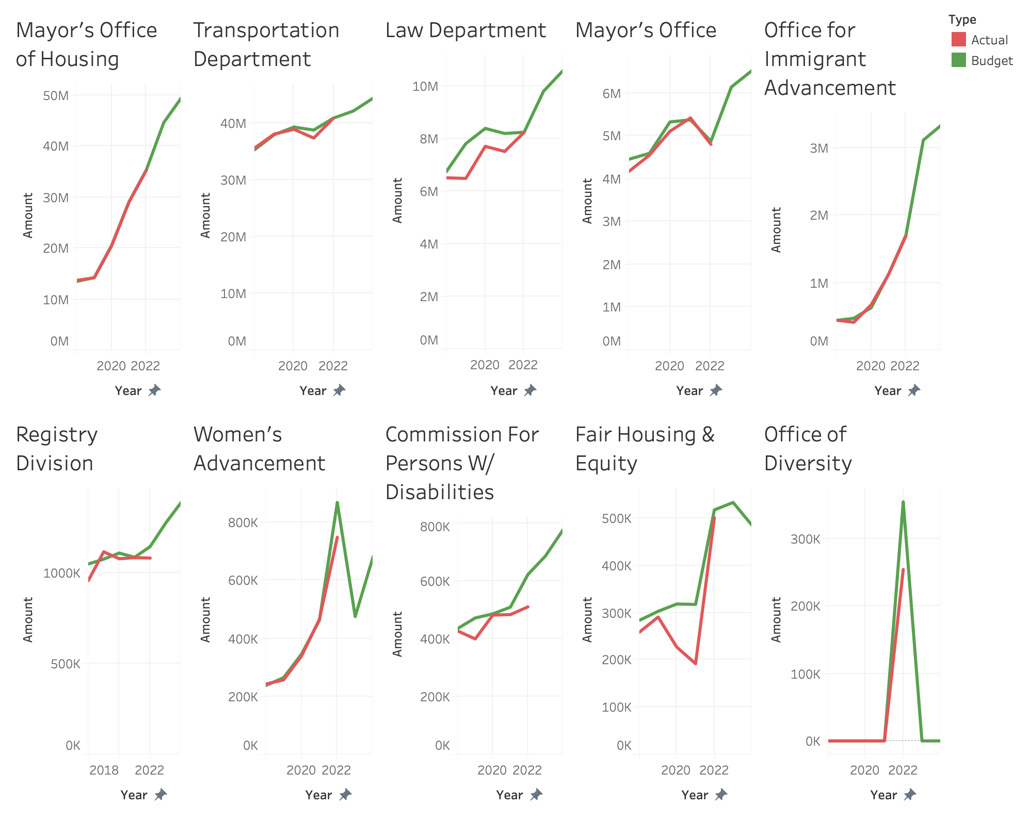
What is the take away?
4. Departments with 2022 Surplus Between $1 and $140K
Lines don’t fit on the graph - can’t see peaks
What is the take away?

